Slide 1
Bài giảng điện tử
Unit Starter
Lesson 2: Language Focus

Slide 2
STARTER UNIT
Lesson 2
Language Focus

Slide 4
TO BE
Ex: 1) I am from Ho Chi Minh city
2) You are a student.
3) She is interested in sport.
→ To be - AM, IS, ARE
: thì, là, ở

Slide 5
I | am (I‘m)
We, you, they | are (we’re, you’re, they’re)
He, she, it | is (he’s, she’s, it’s)

Slide 6
A. Affirmative form
S + am, is, are + O
Ex: a) She is interested in sport.
are
b) They ……………….. into shopping.
c) I ………………. twelve years old.
am

Slide 7
B. Negative form
S + am, is, are + not + O
is not = isn’t
are not = aren’t
Ex: a) She isn’t interested in sport.
are not (aren’t)
b) They …………………….….. into shopping.
c) I …………………….……. twelve years old.
am not

Slide 8
B. Interrogative form
Am, Is, Are + S + O ?
Ex: a) Is she interested in sport?
Are
b) ……………….. they into shopping?

Slide 9
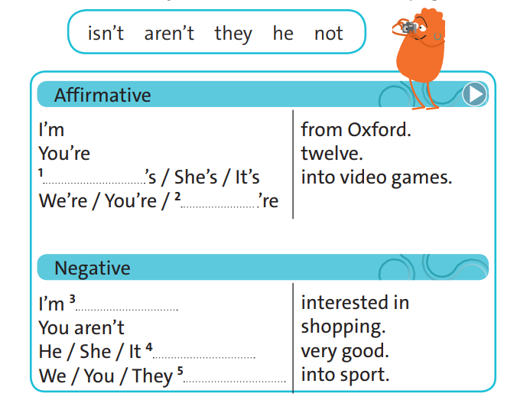
Exercise 1
(P.7)
He
they
not
isn’t
aren’t

Slide 10
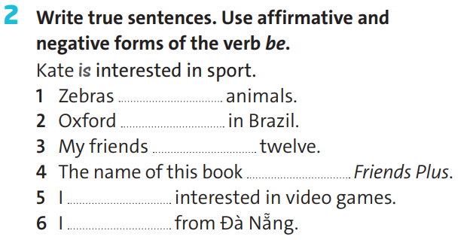
Exercise 1 (P.7)
are
isn’t
are / aren’t
is
‘m / ‘m not
‘m / ‘m not

Slide 11
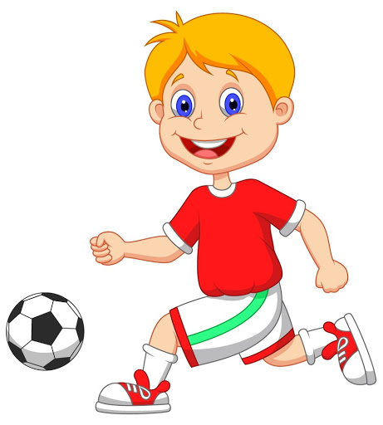
Subject pronouns
We
1. ________are flying a kite. (Dad and I)
He
2. _______likes to play football. (Tom)

Slide 12
They
3. ________are friends. ( Mr. Smith and Dr. Boss)

Slide 13
Subject pronouns – I, you, we, they
he, she, it
are used to replace (thay thế) the subject
(person or thing) of a verb.

Slide 14
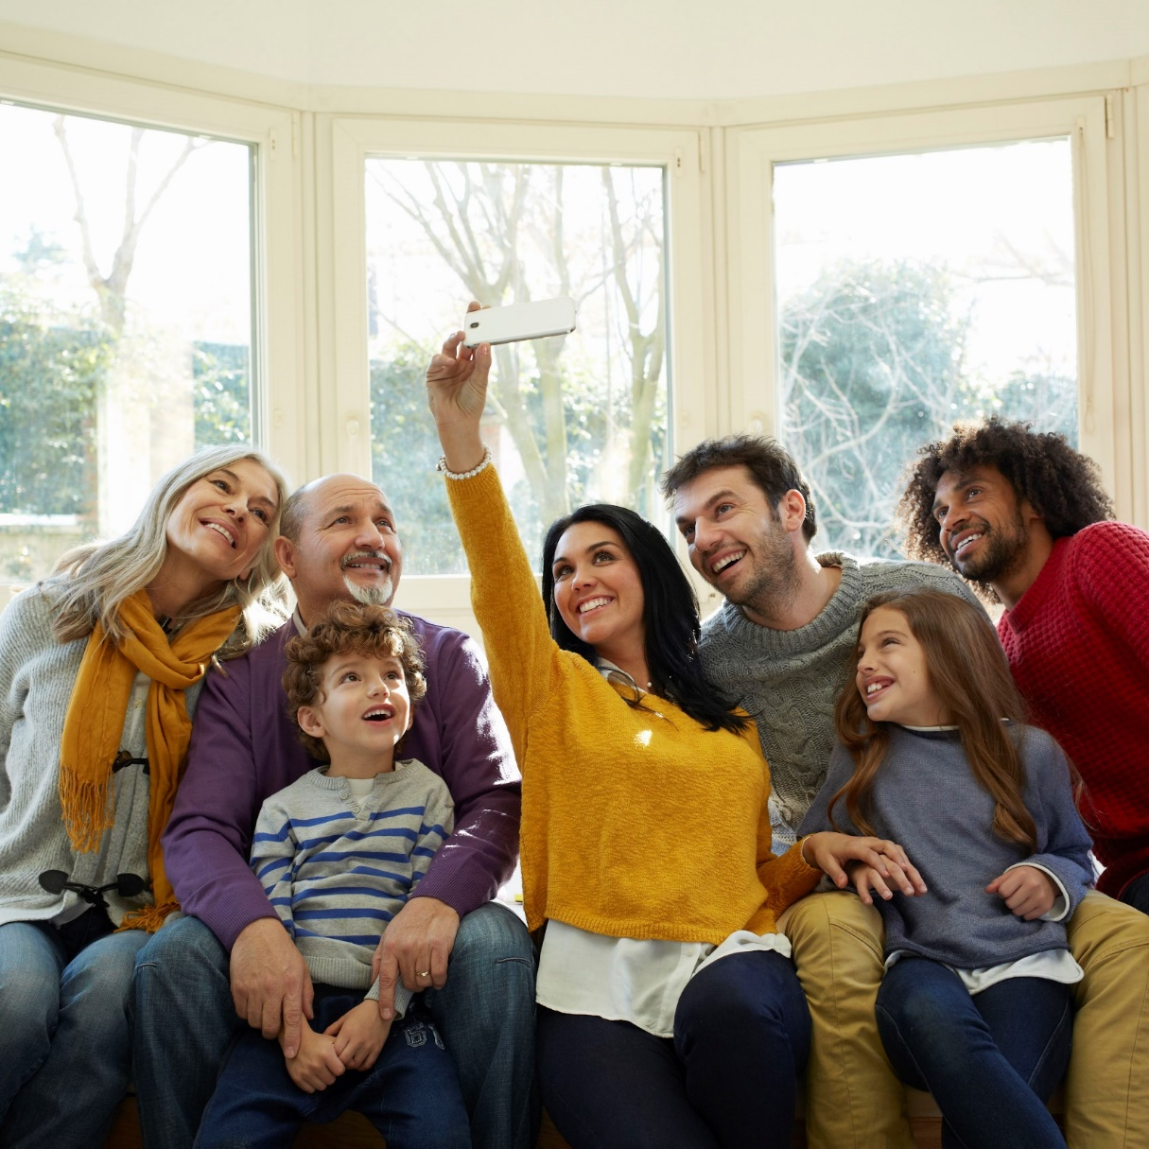
I
1. Hi! My name is Mary Elizabeth. ____ am nine years old. (Mary Elizabeth)

Slide 15
She
2. My mother's name is Andrea.______ is wearing an orange skirt. (Andrea)

Slide 16
He
3.My dad wears glasses._____ is an engineer and his name is Anthony. (Anthony)

Slide 17
He
4. Sammy is my brother.______ is seven years old. (Sammy)

Slide 18
They
5. My grandparents are visiting us._______ are very nice. (Grandparents)

Slide 19
We
7.______ live in South Carolina. (Mary Elizabeth, Sammy and their parents)

Slide 20
they
8. My grandparents live in Florida but______ often visit us. (My grandparents)

Slide 21
It
9._______is not very far from South Carolina. (Florida)

Slide 22
We
10._____ love when our grandparents came to visit us! (Mary Elizabeth and Sammy)

Slide 23
Possessive adjectives
Example: It is your hat.
Possessive Adj
Noun
my, your, his, her, its, our, their + Noun

Slide 24
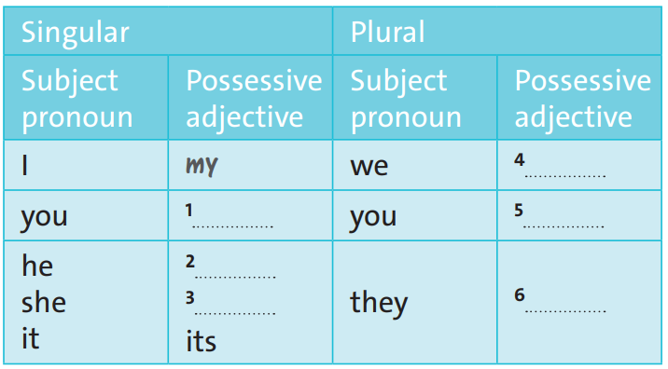
our
your
your
his
their
her

Slide 25
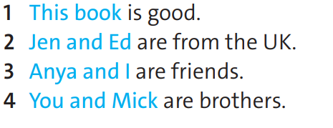
Exercise 4 (P.7)
It
They
We
You

Slide 26
Exercise 5 (P.7)
you
it
him
her
us
you
them

Slide 27
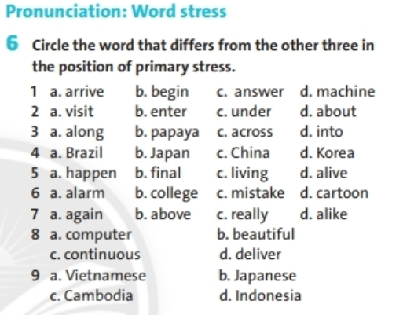

Slide 28
Homework
Learn new words and grammar of the today lesson.
Finish the exercise.
Prepare for the next lesson - Language focus: Prepositions

Slide 29
www.phuongnam.edu.vn

